Slide 2
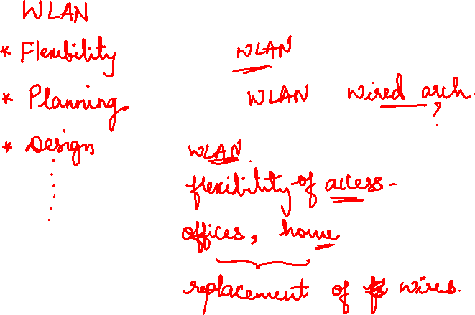

Slide 3

Mobile Communication Technology according to IEEE
WiFi
Local wireless networks
802.11a
802.11h
WLAN 802.11
802.11i/e/…/w
802.11b
802.11g
ZigBee
802.15.4 802.15.4a/b
802.15.5
802.15.3 802.15.3a/b
Personal wireless nw
WPAN 802.15
802.15.1
Bluetooth
802.15.2
Wireless distribution networks
WMAN 802.16 (Broadband Wireless Access)
+ Mobility
WiMAX
802.20 (Mobile Broadband Wireless Access)

Slide 4
Characteristics of wireless LANs
Advantages
very flexible within reception area
Ad-hoc networks do not need planning
(almost) no wiring difficulties (e.g. historic buildings, firewalls)
more robust against disasters like, e.g., earthquakes, fire
Disadvantages
low bandwidth compared to wired networks (1-10 Mbit/s)
many proprietary solutions, especially for higher bit-rates, standards take their time (e.g. IEEE 802.11)
many national restrictions for wireless, long time to establish global solutions like, e.g., IMT-2000

Slide 5
Design goals for wireless LANs
global, seamless operation
low power for battery use
no special permissions or licenses needed to use the LAN
robust transmission technology
simplified spontaneous cooperation at meetings
easy to use for everyone, simple management
protection of investment in wired networks
security (no one should be able to read my data), privacy (no one should be able to collect user profiles), safety (low radiation)
transparency concerning applications and higher layer protocols, but also location awareness if necessary

Slide 6
Comparison: infrared vs. radio transmission
Infrared
uses IR diodes, diffuse light, multiple reflections (walls, furniture etc.)
Advantages
simple, cheap, available in many mobile devices
no licenses needed
simple shielding possible
Disadvantages
interference by sunlight, heat sources etc.
many things shield or absorb IR light
low bandwidth
Example
IrDA (Infrared Data Association) interface available everywhere
Radio
typically using the license free ISM band at 2.4 GHz
Advantages
experience from wireless WAN and mobile phones can be used
coverage of larger areas possible (radio can penetrate walls, furniture etc.)
Disadvantages
limited license free frequency bands
shielding more difficult, electrical interference
Example
Many different products

Slide 7
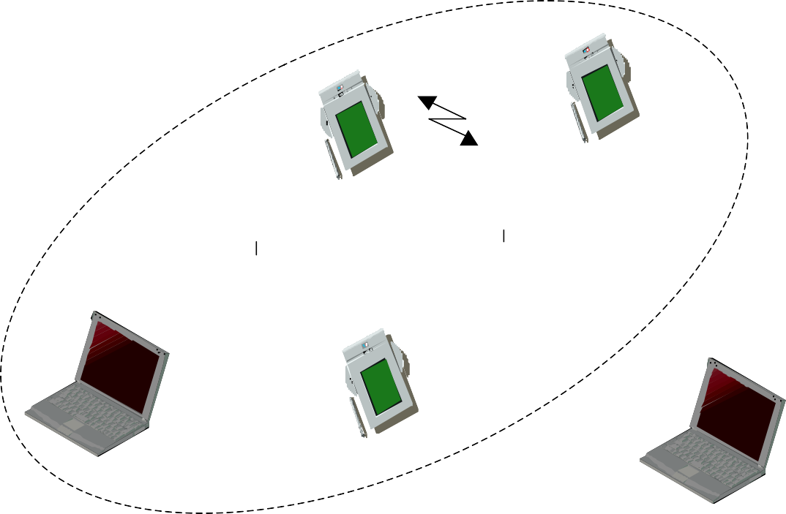

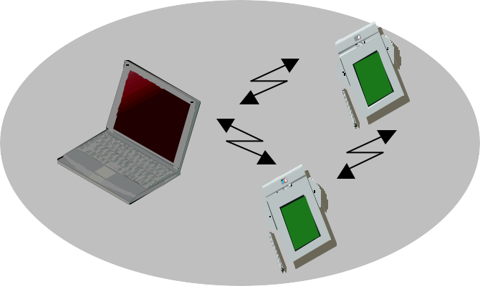
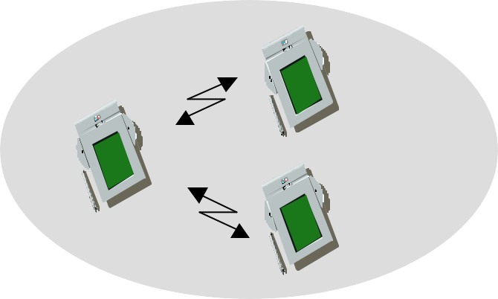
Comparison: infrastructure vs. ad-hoc networks
infrastructure network
AP
AP: Access Point
AP
wired network
AP
ad-hoc network

Slide 8
Infrastructure mode Access point
Access point controls
Medium access
Adhoc mode
Nodes are complex as have to implement all parameters by itself.

Slide 9


802.11 - Architecture of an infrastructure network
Station (STA)
terminal with access mechanisms to the wireless medium and radio contact to the access point
Basic Service Set (BSS)
group of stations using the same radio frequency
Access Point
station integrated into the wireless LAN and the distribution system
Portal
bridge to other (wired) networks
Distribution System
interconnection network to form one logical network (EES: Extended Service Set) based on several BSS
802.11 LAN
802.x LAN
STA₁
Portal
BSS₁
Access Point
Distribution System
Access
ESS
Point
BSS₂
STA₂
802.11 LAN
STA₃

Slide 10
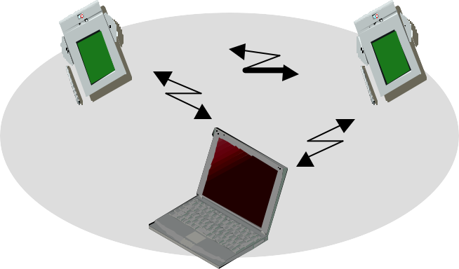
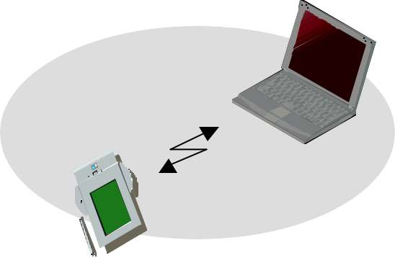
802.11 - Architecture of an ad-hoc network
Direct communication within a limited range
802.11 LAN
Station (STA):
terminal with access mechanisms to the wireless medium
Independent Basic Service Set (IBSS):
group of stations using the same radio frequency
STA₁
IBSS₁
STA₃
STA₂
IBSS₂
STA₅
STA₄
802.11 LAN

Slide 11

IEEE standard 802.11
fixed terminal
mobile terminal
infrastructure network
access point
application
application
TCP
TCP
IP
IP
LLC
LLC
LLC
802.11 MAC
802.11 MAC
802.3 MAC
802.3 MAC
802.11 PHY
802.11 PHY
802.3 PHY
802.3 PHY

Slide 12
802.11 - Layers and functions
MAC
access mechanisms, fragmentation, encryption
MAC Management
synchronization, roaming, MIB, power management
PLCP Physical Layer Convergence Protocol
clear channel assessment signal (carrier sense)
PMD Physical Medium Dependent
modulation, coding
PHY Management
channel selection, MIB
Station Management
coordination of all management functions
Management
DLC | LLC |  | Station
 | MAC | MAC Management
PHY | PLCP | PHY Management
 | PMD

Slide 13
802.11 - Physical layer (classical)
3 versions: 2 radio (typ. 2.4 GHz), 1 IR
data rates 1 or 2 Mbit/s
FHSS (Frequency Hopping Spread Spectrum)
spreading, despreading, signal strength, typ. 1 Mbit/s
min. 2.5 frequency hops/s (USA), two-level GFSK modulation
DSSS (Direct Sequence Spread Spectrum)
DBPSK modulation for 1 Mbit/s (Differential Binary Phase Shift Keying), DQPSK for 2 Mbit/s (Differential Quadrature PSK)
preamble and header of a frame is always transmitted with 1 Mbit/s, rest of transmission 1 or 2 Mbit/s
chipping sequence: +1, -1, +1, +1, -1, +1, +1, +1, -1, -1, -1 (Barker code)
max. radiated power 1 W (USA), 100 mW (EU), min. 1mW
Infrared
850-950 nm, diffuse light, typ. 10 m range
carrier detection, energy detection, synchronization

Slide 14
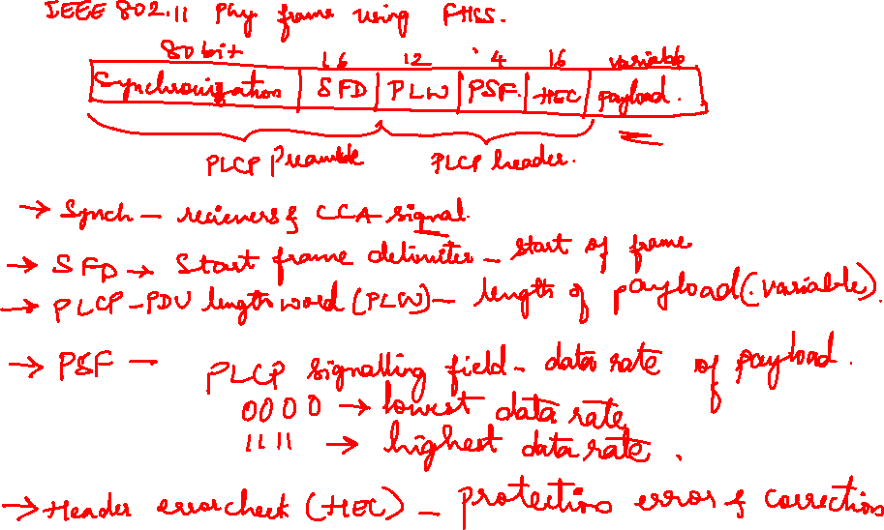

Slide 15
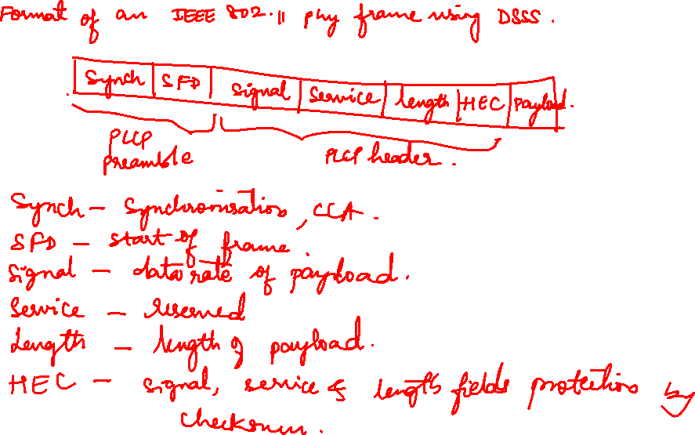

Slide 16
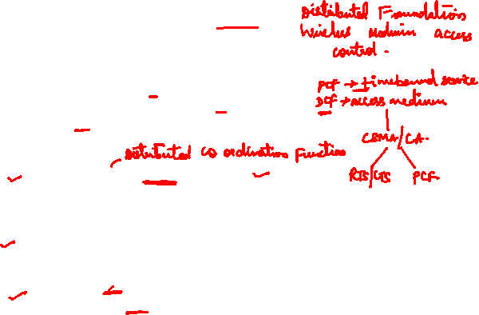
802.11 - MAC layer I - DFWMAC
Traffic services
Asynchronous Data Service (mandatory)
exchange of data packets based on “best-effort”
support of broadcast and multicast
Time-Bounded Service (optional)
implemented using PCF (Point Coordination Function)
Access methods
DFWMAC-DCF CSMA/CA (mandatory)
collision avoidance via randomized „back-off“ mechanism
minimum distance between consecutive packets
ACK packet for acknowledgements (not for broadcasts)
DFWMAC-DCF w/ RTS/CTS (optional)
Distributed Foundation Wireless MAC
avoids hidden terminal problem
DFWMAC- PCF (optional)
access point polls terminals according to a list

Slide 17
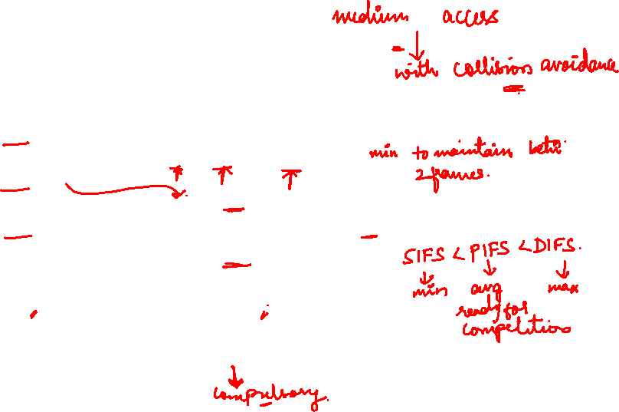
802.11 - MAC layer II
Priorities
defined through different inter frame spaces
no guaranteed, hard priorities
SIFS (Short Inter Frame Spacing)
highest priority, for ACK, CTS, polling response
PIFS (PCF IFS)
medium priority, for time-bounded service using PCF
DIFS (DCF, Distributed Coordination Function IFS)
lowest priority, for asynchronous data service
DIFS
DIFS
PIFS
medium busy
SIFS
contention
next frame
t
direct access if medium is free ≥DIFS

Slide 18
802.11 - CSMA/CA access method I
contention window (randomized back-off mechanism)
DIFS
DIFS
medium busy
next frame
direct access if medium is free ≥DIFS
t
slot time
station ready to send senses medium (based on PHY layer CCA, Clear Channel Assessment)
if the medium is free for the duration of an Inter-Frame Space (IFS), the station can start sending (IFS depends on service type)
if the medium is busy, the station has to wait for a free IFS, then the station must additionally wait a random back-off time (collision avoidance, multiple of slot-time)
if another station occupies the medium during the back-off time of the station, the back-off timer stops (fairness)
If multiple stations have backed off, when 1 timer expires, other timers frozen

Slide 19
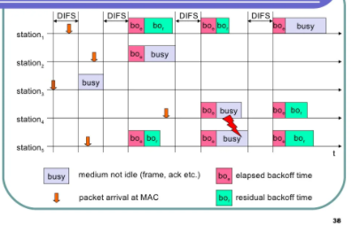
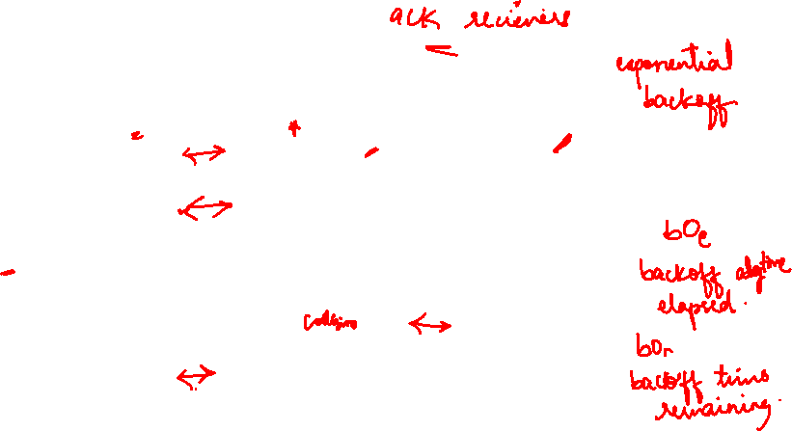

Slide 20

802.11 - CSMA/CA access method II
Sending unicast packets
station has to wait for DIFS before sending data
receivers acknowledge at once (after waiting for SIFS) if the packet was received correctly (CRC)
automatic retransmission of data packets in case of transmission errors
DIFS
data
sender
SIFS
ACK
receiver
DIFS
data
other stations
t
waiting time
contention

Slide 21
802.11 - DFWMAC
Sending unicast packets
station can send RTS with reservation parameter after waiting for DIFS (reservation determines amount of time the data packet needs the medium)
acknowledgement via CTS after SIFS by receiver (if ready to receive)
sender can now send data at once, acknowledgement via ACK
other stations store medium reservations distributed via RTS and CTS
DIFS
RTS
data
sender
SIFS
SIFS
CTS
SIFS
ACK
receiver
NAV (RTS)
DIFS
data
other stations
NAV (CTS)
t
defer access
contention

Slide 22

Fragmentation
DIFS
RTS
frag₁
frag₂
sender
SIFS
CTS
SIFS
SIFS
ACK₁
SIFS
SIFS
ACK₂
receiver
NAV (RTS)
NAV (CTS)
NAV (frag₁)
DIFS
data
other stations
NAV (ACK₁)
t
contention

Slide 23
DFWMAC-PCF I
t₀ t₁
SuperFrame
medium busy
PIFS
SIFS
SIFS
D₁
D₂
point
coordinator
SIFS
SIFS
U₁
U₂
wireless stations
stations‘ NAV
NAV

Slide 24
802.11 - MAC management
Synchronization
Clock skew may happen
Infrastructure: AP broadcasts beacons, other nodes correct skew
Ad hoc: All nodes broadcast beacons
Power management
Save battery, nodes can go to sleep, wake up periodically to receive
Infrastructure: AP buffers packets for sleeping nodes
Ad hoc: sender buffers packets for sleeping destinations
Association/Reassociation
Roaming: Move from access point to access point as user moves
scanning, i.e. active search for a network
Node sends message to new AP, says goodbye to old AP
MIB - Management Information Base
All information for managing network, node stored in SNMP MIB
MIB can be read (access) or written to (update)

Slide 25
Power management in infrastructure-based networks is much simpler compared
to ad-hoc networks. The access point buffers all frames destined for stations operating in power-save mode. With every beacon sent by the access point, a traffic indication map (TIM) is transmitted. The access point maintains a delivery traffic indication map
(DTIM) interval for sending broadcast/multicast frames

Slide 26
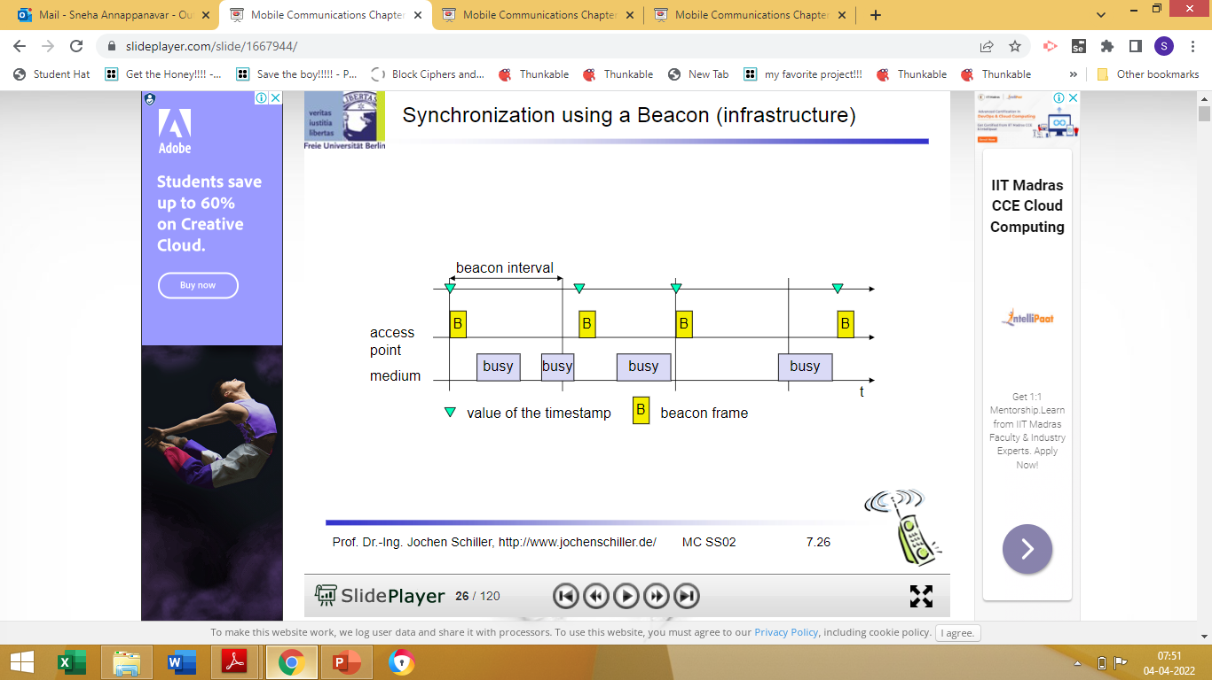
SYNCHRONISATION
Within a BSS, timing is conveyed by the (quasi)periodic transmissions of a beacon frame. A beacon contains a timestamp and other management information used for power management and roaming.
The timestamp is used by a node to adjust its local clock. The node is not required to hear every beacon to stay synchronized; however, from time to time internal clocks should be adjusted. The transmission of a beacon frame is not always periodic because the beacon frame is also deferred if the medium is busy.
Synchronisation for Infrastructure mode

Slide 27
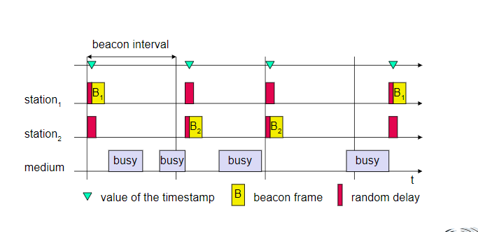
Sync for adhoc network

Slide 28
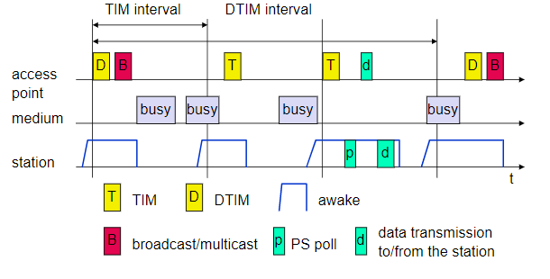

Slide 29
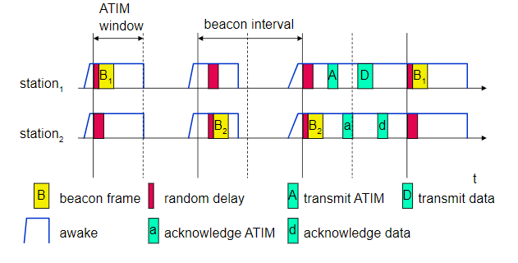

Slide 30
WLAN: IEEE 802.11b
Data rate
1, 2, 5.5, 11 Mbit/s, depending on SNR
User data rate max. approx. 6 Mbit/s
Transmission range
300m outdoor, 30m indoor
Max. data rate ~10m indoor
Frequency
Free 2.4 GHz ISM-band
Security
Limited, WEP insecure, SSID
Availability
Many products, many vendors
Connection set-up time
Connectionless/always on
Quality of Service
Typ. Best effort, no guarantees (unless polling is used, limited support in products)
Manageability
Limited (no automated key distribution, sym. Encryption)
Special Advantages/Disadvantages
Advantage: many installed systems, lot of experience, available worldwide, free ISM-band, many vendors, integrated in laptops, simple system
Disadvantage: heavy interference on ISM-band, no service guarantees, slow relative speed only

Slide 31
WLAN: IEEE 802.11a
Data rate
6, 9, 12, 18, 24, 36, 48, 54 Mbit/s,
depending on SNR
User throughput (1500 byte packets): 5.3 (6), 18 (24), 24 (36), 32 (54)
6, 12, 24 Mbit/s mandatory
Transmission range
100m outdoor, 10m indoor
E.g., 54 Mbit/s up to 5 m, 48 up to 12 m, 36 up to 25 m, 24 up to 30m, 18 up to 40 m, 12 up to 60 m
Frequency
Free 5.15-5.25, 5.25-5.35, 5.725-5.825
GHz ISM-band
Security
Limited, WEP insecure, SSID
Availability
Some products, some vendors
Connection set-up time
Connectionless/always on
Quality of Service
Typ. best effort, no guarantees (same as all 802.11 products)
Manageability
Limited (no automated key distribution, sym. Encryption)
Special Advantages/Disadvantages
Advantage: fits into 802.x standards, free ISM-band, available, simple system, uses less crowded 5 GHz band
Disadvantage: stronger shading due to higher frequency, no QoS

Slide 32
WLAN: IEEE 802.11 – future developments (03/2005)
802.11c: Bridge Support
Definition of MAC procedures to support bridges as extension to 802.1D
802.11d: Regulatory Domain Update
Support of additional regulations related to channel selection, hopping sequences
802.11e: MAC Enhancements – QoS
Enhance the current 802.11 MAC to expand support for applications with Quality of Service requirements, and in the capabilities and efficiency of the protocol
Definition of a data flow (“connection”) with parameters like rate, burst, period…
Additional energy saving mechanisms and more efficient retransmission
802.11f: Inter-Access Point Protocol
Establish an Inter-Access Point Protocol for data exchange via the distribution system
Currently unclear to which extend manufacturers will follow this suggestion
802.11g: Data Rates > 20 Mbit/s at 2.4 GHz; 54 Mbit/s, OFDM
Successful successor of 802.11b, performance loss during mixed operation with 11b
802.11h: Spectrum Managed 802.11a
Extension for operation of 802.11a in Europe by mechanisms like channel measurement for dynamic channel selection (DFS, Dynamic Frequency Selection) and power control (TPC, Transmit Power Control)

Slide 33
WLAN: IEEE 802.11– future developments (03/2005)
802.11i: Enhanced Security Mechanisms
Enhance the current 802.11 MAC to provide improvements in security.
TKIP enhances the insecure WEP, but remains compatible to older WEP systems
AES provides a secure encryption method and is based on new hardware
802.11j: Extensions for operations in Japan
Changes of 802.11a for operation at 5GHz in Japan using only half the channel width at larger range
802.11k: Methods for channel measurements
Devices and access points should be able to estimate channel quality in order to be able to choose a better access point of channel
802.11m: Updates of the 802.11 standards
802.11n: Higher data rates above 100Mbit/s
Changes of PHY and MAC with the goal of 100Mbit/s at MAC SAP
MIMO antennas (Multiple Input Multiple Output), up to 600Mbit/s are currently feasible
However, still a large overhead due to protocol headers and inefficient mechanisms
802.11p: Inter car communications
Communication between cars/road side and cars/cars
Planned for relative speeds of min. 200km/h and ranges over 1000m
Usage of 5.850-5.925GHz band in North America

Slide 34
WLAN: IEEE 802.11– future developments (03/2005)
802.11r: Faster Handover between BSS
Secure, fast handover of a station from one AP to another within an ESS
Current mechanisms (even newer standards like 802.11i) plus incompatible devices from different vendors are massive problems for the use of, e.g., VoIP in WLANs
Handover should be feasible within 50ms in order to support multimedia applications efficiently
802.11s: Mesh Networking
Design of a self-configuring Wireless Distribution System (WDS) based on 802.11
Support of point-to-point and broadcast communication across several hops
802.11t: Performance evaluation of 802.11 networks
Standardization of performance measurement schemes
802.11u: Interworking with additional external networks 802.11v: Network management
Extensions of current management functions, channel measurements
Definition of a unified interface
802.11w: Securing of network control
Classical standards like 802.11, but also 802.11i protect only data frames, not the control frames. Thus, this standard should extend 802.11i in a way that, e.g., no control frames can be forged.
Note: Not all “standards” will end in products, many ideas get stuck at working group level Info: www.ieee802.org/11/, 802wirelessworld.com, standards.ieee.org/getieee802/

Slide 35




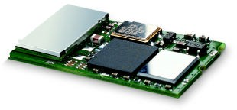


Bluetooth
Idea
Universal radio interface for ad-hoc wireless connectivity
Interconnecting computer and peripherals, handheld devices, PDAs, cell phones – replacement of IrDA
Embedded in other devices
Short range (10 m), low power consumption, license-free 2.45 GHz ISM
Voice and data transmission.
One of the first modules (Ericsson).

Slide 36
Characteristics
FHSS and TDD
Frequency hopping with 1600 hops/s
Hopping sequence in a pseudo random fashion, determined by a master
Time division duplex for send/receive separation
Voice link – SCO (Synchronous Connection Oriented)
FEC (forward error correction), no retransmission, 64 kbit/s duplex, point- to-point, circuit switched
Data link – ACL (Asynchronous ConnectionLess)
Asynchronous, fast acknowledge, point-to-multipoint, up to 433.9 kbit/s symmetric or 723.2/57.6 kbit/s asymmetric, packet switched
Topology
Overlapping piconets (stars) forming a scatternet

Slide 37
User scenario
Connection of peripheral devices-no wires, replace power supply from connection to battery
Support of ad-hoc networking-helps in sharing data for more than one device.
Bridging of networks- exchange of data between wireless networks or even wired networks.

Slide 38
Piconet
Collection of devices connected in an ad hoc fashion
P
S
One unit acts as master and the others as slaves for the lifetime of the piconet
S
M
P
Master determines hopping pattern, slaves have to synchronize
SB
S
P
SB
Each piconet has a unique hopping pattern
Participation in a piconet = synchronization to hopping sequence
M=Master S=Slave
P=Parked SB=Standby
Each piconet has one master and up to 7 simultaneous slaves (> 200 could be parked)

Slide 39
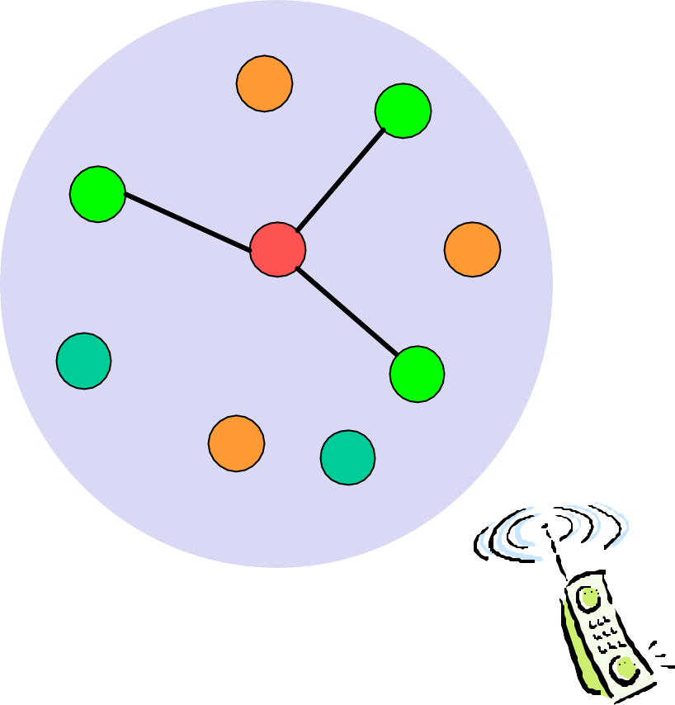
Forming a piconet
All devices in a piconet hop together
Master gives slaves its clock and device ID
Hopping pattern: determined by device ID (48 bit, unique worldwide)
Phase in hopping pattern determined by clock
Addressing
Active Member Address (AMA, 3 bit)
Parked Member Address (PMA, 8 bit)

P

•
S
SB

SB


S
 
SB

M
P
SB
SB




SB
S
SB



SB
P

SB
SB
SB

Slide 40
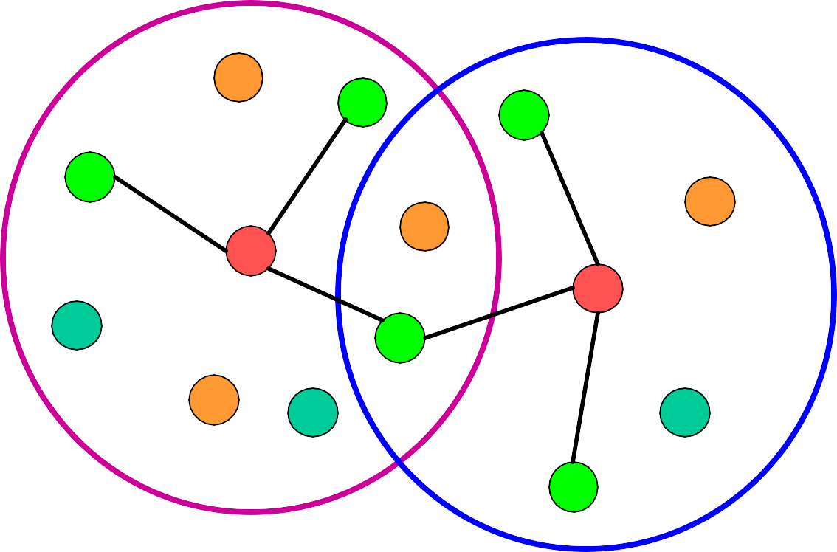
Scatternet
Linking of multiple co-located piconets through the sharing of common master or slave devices
Devices can be slave in one piconet and master of another
Communication between piconets
Devices jumping back and forth between the piconets
Piconets (each with a capacity of 720 kbit/s)
P
S
S
S
P
P
M
M
SB
S
M=Master S=Slave P=Parked SB=Standby
P
SB
SB
S

Slide 41
Bluetooth protocol stack
audio apps.
NW apps.
vCal/vCard
telephony apps.
mgmnt. apps.
TCP/UDP
OBEX
IP
AT modem commands
TCS BIN SDP
BNEP PPP
Control
RFCOMM (serial line interface)
Audio
Logical Link Control and Adaptation Protocol (L2CAP)
Host Controller Interface
Link Manager
Baseband
Radio
AT: attention sequence OBEX: object exchange
TCS BIN: telephony control protocol specification – binary
BNEP: Bluetooth network encapsulation protocol
SDP: service discovery protocol RFCOMM: radio frequency comm.

Slide 42
Radio –frequency, modulation, air interface, transmit power
Base band-description of basic connection establishment, packet formats, timing and basic QoS parameters.
Link Manager Protocol- Link setup and management between devices including security functions and parameters negotiation.
L2CAP-Adaptation of higher layers to baseband(connection oriented and connectionless services.
Service Discovery Protocol-device discovery in close proximity plus querying of service characteristics.
RFCOMM-Cable replacement protocol by replacing serial line cables and enables many application and protocols to run on Bluetooth multiple serial ports over single physical channel.

Slide 43
TCS BIN- bit oriented protocol defining call control signalling for establishment of voice and data calls between Bluetooth devices along with group management and mobility functions.
HCI(Host Controller Interface)-between base band and L2CAP provides command interface between baseband controller and access to the hardware status and control registers.

Slide 44
L2CAP - Logical Link Control and Adaptation Protocol
Simple data link protocol on top of baseband
Connection oriented, connectionless, and signalling channels Protocol multiplexing
RFCOMM, SDP, telephony control
Segmentation & reassembly
Up to 64kbyte user data, 16 bit CRC used from baseband
QoS flow specification per channel
Follows RFC 1363, specifies delay, jitter, bursts, bandwidth
Group abstraction
Create/close group, add/remove member

Slide 45
Security
User input (initialization) Pairing
PIN (1-16 byte)
PIN (1-16 byte)
E₂
Authentication key generation (possibly permanent storage)
E₂
link key (128 bit)
Authentication
link key (128 bit)
E₃
Encryption key generation (temporary storage)
E₃
encryption key (128 bit)
Encryption
encryption key (128 bit)
Keystream generator
Keystream generator
payload key
Ciphering
Cipher data
payload key
Data
Data

Slide 46
SDP – Service Discovery Protocol
Inquiry/response protocol for discovering services
Searching for and browsing services in radio proximity
Adapted to the highly dynamic environment
Can be complemented by others like SLP, Jini, Salutation, …
Defines discovery only, not the usage of services
Caching of discovered services
Gradual discovery

Slide 47
Additional protocols to support legacy protocols/apps.
RFCOMM
Emulation of a serial port (supports a large base of legacy applications)
Allows multiple ports over a single physical channel
Telephony Control Protocol Specification (TCS)
Call control (setup, release)
Group management
OBEX
Exchange of objects, IrDA replacement
WAP
Interacting with applications on cellular phones

